Slide 1
Concept for EUROSAI Project Group:
Auditing the response to the COVID-19 pandemic
Kevin Summersgill
UK National Audit Office

Slide 2
Reason for action: April 2020
COVID-19 is a global problem and SAIs have a role to play.
The virus has infected 2 million people worldwide, killing over 130,000 (as at 24 April).
Governments will need to cooperate with each other, with the WHO (and other parts of the UN system) as part of a global response.
SAIs recognise the exceptional impact of COVID-19 on Governments, and the unprecedented response
We are also clear that our work must not have a negative impact on capacity to respond to the crisis
We are carefully considering how to play our role and provide Parliament and the public with the evidence they need to understand how public money has been used in tackling this crisis. We will also help ensure that the appropriate lessons are learned for the future.
SAIs are all considering what, in their context, an appropriate audit response would look like.
The response to the pandemic will have global implications for public spending and public service delivery.
It is too early to tell exactly what the impact will be, but it will last many years and be profound. However…
Government responses are similar, and therefore the ‘audit universe’ is similar: e.g.
A four stage systemic response: Preparedness, Response, Exit strategy, Managing long-term effects underpinned by Continuous Learning
An initial focus on three main public policy areas:
Healthcare (including provision of services, supply and logistics),
Wider emergency response (including civil restrictions and public safety) and
Protecting the economy (including support for businesses, Individuals particularly the vulnerable)
This is an opportunity for EUROSAI members to cooperate.
SAIs can support each other - even though we might decide to approach the COVID-19 pandemic differently in view of our different priorities and mandates.
Establishing a COVID-19 project group is in line with the EUROSAI strategy under the Emerging issues and Forward thinking strategic portfolio.
There are clear benefits in increasing our collective ability to deliver quality audits.
Share knowledge, our audit approach and ideas
Share contacts, sources of publicly available information (and perhaps quality assure them)
A quick and effective way to collaborate.

Slide 3
Concept: COVID-19 Project Group
The project will be conducted under the Emerging issues and Forward thinking strategic portfolio. The nature and aims of this Project Group support the EUROSAI Strategic Plan (Strategic Goal 1, objectives 1.2 and 1.3.1). The project group will coordinate EUROSAI’s response to the COVID-19 pandemic by;
1. Supporting effective, innovative and relevant audits by promoting and brokering professional cooperation;
2. Helping SAIs deal with new opportunities and challenges by supporting and facilitating their institutional capacity development.
EUROSAI Strategic Objectives
Coordination and communication of EUROSAI members’ COVID-19 work. This includes liaison with INTOSAI COVID-19 initiatives (e.g. PFAC COVID-19 working group) or wider initiatives the group feels may support it;
Facilitate sharing of audit approaches / outputs; e.g. designing a COVID-19 audit programme using the most appropriate audit approaches, sharing messages and learning from our reports; and
Scope content for any future lessons learned reports; e.g. common questions / audit framework, key facts / information for each SAI to collect and use domestically, which we can all benefit from internationally.
COVID-19 Project group key activities
Guiding principles
SAIs have an important job to do. We should be confident in our role helping ensure public money is used wisely even at a time of crisis.
Different SAI’s priorities are respected. We are not seeking to influence each other’s approach but to inform and strengthen it by learning from others. This is a coalition of the willing
Respect the principle of ‘do no harm’. We understand the pressure COVID-19 is putting on our governments. Each SAI will need to consider the timing and impact of any audits.
Different approaches will be needed: There is value in starting early with simple, factual work to support Parliaments in examining issues, before moving on to more evaluative work
Cooperation should be as effective as possible. This group will coordinate EUROSAI COVID-19 activities including liaison with the INTOSAI PFAC initiative and other INTOSAI regions.
Next steps
Establish project group
Set up BIEP topic as the primary knowledge sharing tool
Build a coalition of the willing – open to any interested EUROSAI member
Hold first virtual meeting to discuss objectives
Set up webinars to share experiences, create a summary of the current state, design the operational plan

Slide 4
Project status and next steps
Signing up to the PG does not mean signing up for all PG activities – participation must make sense for each SAI’s priorities and mandates
We are now in the ‘Planning phase’ of the project
We are aiming for two outputs from the planning phase:
A summary of the roundtable discussions on current status and audit plans
An operation plan for the ‘Delivery phase’ over the next 12 months

Slide 5
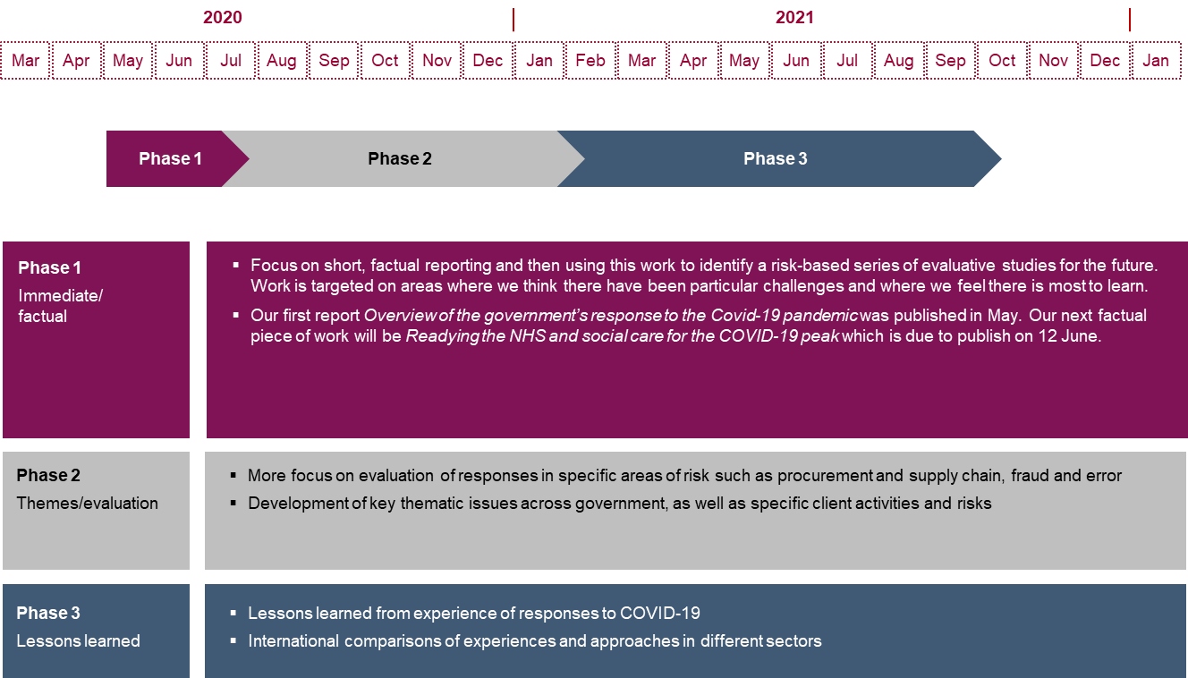
UK NAO audit response – 3 phases
… and in case of interest: https://www.nao.org.uk/covid-19/

Slide 6
Thank you for your valuable time
Any questions?

